Slide 2
Course Overview
Day 1: Introduction to ML, Model Building, Text Processing, Bag of Words (BoW), and K Nearest Neighbors Model (KNN)
Day 2: Tree-based Models, Regression Models, Optimization, Regularization, Hyperparameter Tuning, AWS AI/ML Services
Day 3: Neural Networks, Word Embeddings, Recurrent Neural Networks (RNN), and Transformers
Day 4: Tabular Data, AutoGluon, Image Classification, Convolutional Neural Networks (CNN), and Transfer Learning

Slide 3
Topics for Day 1
Introduction to Machine Learning
Data Processing
Model Evaluation
Text Processing
Bag of Words Method (BoW)
K Nearest Neighbors Model (KNN)
Final Project

Slide 4
Topics for Day 1
Introduction to Machine Learning
Data Processing
Model Evaluation
Text Processing
Bag of Words Method (BoW)
K Nearest Neighbors Model (KNN)
Final Project

Slide 5
What is Data Science?
Machine Learning
Wikipedia describes Data Science as:
“a multi-disciplinary field that uses scientific methods, processes, algorithms and systems to extract knowledge and insights from structured and unstructured data.”
MACHINE LEARNING
MATHEMATICS
COMPUTER
SCIENCE
DATA
SCIENCE
STATISTICAL
RESEARCH
DATA
PROCESSING
DOMAIN
EXPERTISE
https://en.wikipedia.org/wiki/Data_science

Slide 6


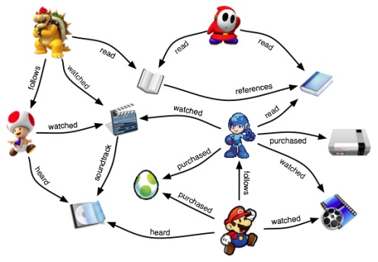

Why Machine Learning?
Some programs are difficult or impossible to write explicitly
We may not know how (task too complex), e.g., face recognition
Too much relevant data, e.g., stock market prediction
Relevant information may only become available dynamically, e.g., a recommendation system
Humans handle this by improving based on experience (data)

Slide 7
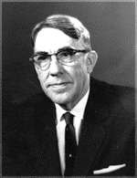
What is Machine Learning?
“The field of study that gives computers the ability to learn without being explicitly programmed”
Arthur Samuel Pioneer of AI research
Data
Classical Programming
Machine Learning Algorithm
Machine Learning Model (Rules)
Answers
Data
Answers
Rules
Problem
Data
Algorithm
Model
Output

Slide 8
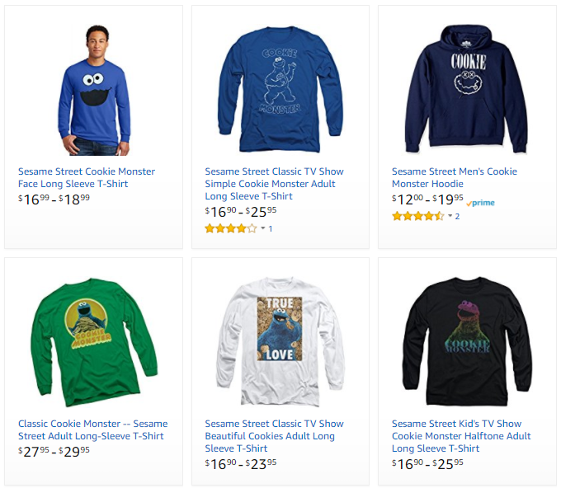
Machine Learning Problems
Problem type
Description
Example
Ranking
Helping users find the most relevant thing
Ranking algorithm within Amazon Search
Recommendation
Giving users the thing they may be most interested in
Classification
Figuring out what kind of thing something is
Regression
Predicting a numerical value of a thing
Clustering
Putting similar things together
Anomaly Detection
Finding uncommon things

Slide 9
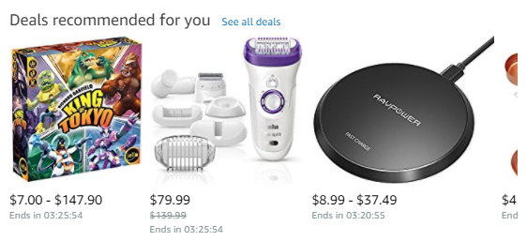
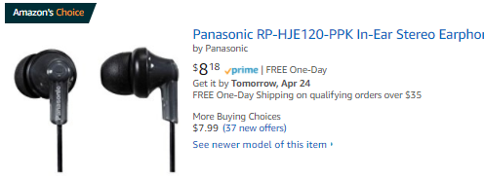
Machine Learning Problems
Problem type
Description
Example
Ranking
Helping users find the most relevant thing
Recommendations across the website
Amazon’s Choice
Recommendation
Giving users the thing they may be most interested in
Classification
Figuring out what kind of thing something is
Regression
Predicting a numerical value of a thing
Clustering
Putting similar things together
Anomaly Detection
Finding uncommon things

Slide 10

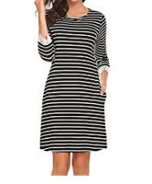
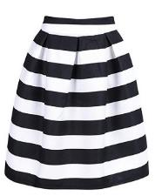
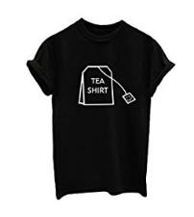
Machine Learning Problems
Problem type
Description
Example
Ranking
Helping users find the most relevant thing
Product classification for our catalog
Recommendation
Giving users the thing they may be most interested in
Classification
Figuring out what kind of thing something is
High-Low Dress
Straight Dress
Regression
Predicting a numerical value of a thing
Clustering
Putting similar things together
Anomaly Detection
Finding uncommon things
Striped Skirt
Graphic Shirt

Slide 11

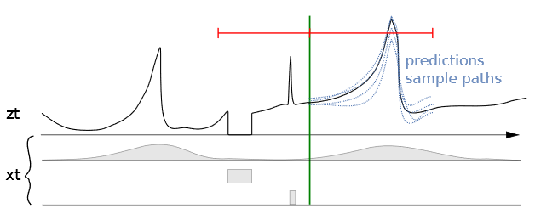
Machine Learning Problems
Problem type
Description
Example
Ranking
Helping users find the most relevant thing
Predicting sales for specific ASINs
Recommendation
Giving users the thing they may be most interested in
Classification
Figuring out what kind of thing something is
Regression
Predicting a numerical value of a thing
Clustering
Putting similar things together
Anomaly Detection
Finding uncommon things
Seasonality | Out of stock | Promotions

Slide 12
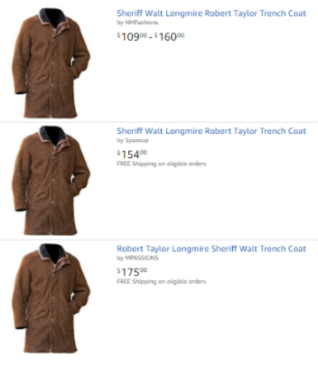
Machine Learning Problems
Problem type
Description
Example
Ranking
Helping users find the most relevant thing
Close-matching for near-duplicates
Recommendation
Giving users the thing they may be most interested in
Classification
Figuring out what kind of thing something is
Regression
Predicting a numerical value of a thing
Clustering
Putting similar things together
Anomaly Detection
Finding uncommon things

Slide 13


Machine Learning Problems
Problem type
Description
Example
Ranking
Helping users find the most relevant thing
Fruit freshness
Recommendation
Giving users the thing they may be most interested in
Before
After
Classification
Figuring out what kind of thing something is
Regression
Predicting a numerical value of a thing
Clustering
Putting similar things together
Good
Damage
Serious Damage
Decay
Anomaly Detection
Finding uncommon things

Slide 14
Supervised vs. Unsupervised Learning
Supervised Learning
Unsupervised Learning
Supervised Learning
Data is provided with the correct labels
Regression (Quantity)
Classification (Category)
Data is provided without labels
K-Means
Collaborative Filtering
PCA
Linear
KNN
Neural Net
Trees
SVM
Logistic

Slide 15
Supervised Learning - Regression
Supervised Learning
Data is provided with the correct labels
Regression (Quantity)
Classification (Category)
Target
Features
Price | Bedrooms | SqFootage | Age
280.000 | 3 | 3292 | 14
210.030 | 2 | 2465 | 6
Linear
KNN
Neural Net
Trees
SVM
Logistic

Slide 16
Supervised Learning - Classification
Supervised Learning
Data is provided with the correct labels
Regression (Quantity)
Classification (Category)
Target
Features
Star | Points | Edges | Size
1 | 5 | 10< | 150
0 | 0 | >9 | 750
Linear
KNN
Neural Net
Trees
SVM
Logistic

Slide 17
Unsupervised Learning - Clustering
Unsupervised Learning
Data is provided without labels
Features
Source | Region | Employees | GMS
Google | West | 1-50 | 150K
LinkedIn | East | 100-200 | 750K
K-Means
Collaborative Filtering
PCA

Slide 18
Unsupervised Learning - Clustering
Unsupervised Learning
Data is provided without labels
Features
Source | Region | Employees | GMS
Google | West | 1-50 | 150K
LinkedIn | East | 100-200 | 750K
K-Means
Collaborative Filtering
PCA

Slide 19
Machine Learning and Statistics
ML optimizes on predictive performance, while statistics places importance on interpretability and parsimony/simplicity.
ML | Statistics | Simply Put
Label/Target | Dependent/Response/Output Variable | The thing you’re trying to predict.
Feature | Independent/Explanatory/Input Variable | Data that help you make predictions.
Feature Engineering | Transformation | Reshaping data to get more value.
Feature Selection | Variable/Subset Selection | Using the most valuable data.

Slide 20
Topics for Day 1
Introduction to Machine Learning
Data Processing
Model Evaluation
Text Processing
Bag of Words Method (BoW)
K Nearest Neighbors Model (KNN)
Final Project

Slide 21
Training - Validation - Test Datasets
Original Dataset
Training Set
Training Set
(used to train the model)
Validation Set
(used for unbiased evaluation of the model)
Test Set
Test Set
(used for final evaluation of the model)
Train, tune and validate the model (multiple times!)
(Final) Model Testing
Why do we divide the data into these three sub-datasets?
How do we make sure our model generalizes well?

Slide 22
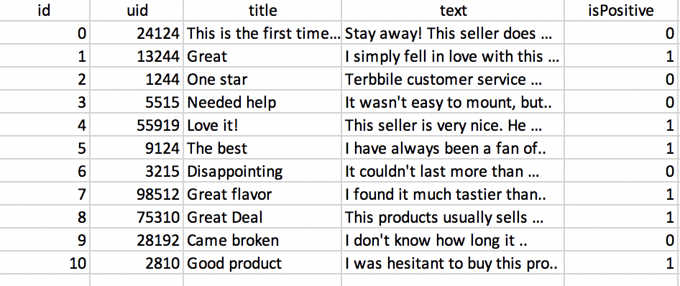
Training - Validation - Test Datasets
Original Dataset
Training Set
Training Set
(used to train the model)
Validation Set
(used for unbiased evaluation of the model)
Test Set
Test Set
(used for final evaluation of the model)
Train, tune and validate the model (multiple times!)
(Final) Model Testing
Training Set
It is good practice to shuffle the dataset before the split to avoid bias in the resulting sets.
Validation Set
Test Set

Slide 23
Model Evaluation - Underfitting
Underfitting: Model is not good enough to describe the relationship between the input data (x, y) and the output (Class).
Model is too simple to capture important patterns of training set.
Corresponds to high bias - results show systematic lack of fit in certain regions.
Model will perform poorly on training and test.
y
Class 1
Class 2
Class 1
Class 2
x

Slide 24
Model Evaluation - Overfitting
Overfitting: Model memorizes or imitates training data, and doesn’t generalize well on new “unseen” data (test data).
Model is too complex, picks up the noise instead of the underlying relationship.
Corresponds to high variance – small changes in the training data lead to big result changes.
Model will perform well on training, but poorly on test.
y
Class 1
Class 2
Class 1
Class 2
x

Slide 25
Model Evaluation - Appropriate Fitting
Appropriate fitting: Model captures the general relationship between the input data (x, y) and the output (Class).
Bias-variance trade-off, model not too simple and not too complex.
Corresponds to low bias and low variance, picks up the underlying relationship rather than the noise in the training.
Model will perform good enough on training and test.
y
Class 1
Class 2
Class 1
Class 2
x
Error ~ Bias + Variance

Slide 26
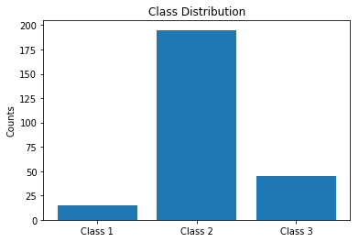
Data Class Imbalance
In imbalanced datasets, the number of data points for each class is not equally distributed.
Often, there are many data points for one class (the dominant class), but much fewer for the other classes (the rare classes).

Slide 27
Data Class Imbalance
How to solve class imbalance problem?
Downsampling: Downsample the dominant class(es).
Upsampling: Upsample the rare or small class(es). It creates identical records.
Data generation: Create new records that are similar but not identical. For example: In computer vision, create similar images distorting original images by rotating, introducing noise or skewing.
Up/down weights: For a model that uses a cost function, assign higher weights to rare class(es) and lower weights to dominant class(es).

Slide 28
Handling Missing Data
How can we handle the missing values of the following product review dataset?
title | text | rating | isPositive
Good | I was very happy with this purchase… | 4.0 | 1
Expensive | Not worth the price. Most of the… |  | 0
 | It works fast and … | 5.0 | 1
Not impressed | Low quality material. I could … | 2.0 | 0
Broken! |  | 1.0 | 0
Nice | I have been waiting for the … | 5.0 | 1
?
?
?

Slide 29
Handling Missing Data
Drop rows and/or columns with missing values: Remove those rows and/or columns from the dataset.
Less training data samples and/or less features can lead to overfitting/underfitting.
Imputation: Fill-in the missing values.
Average imputation: Only for numerical values. Take the average of the values in that column.
Common point imputation: Only for categorical data. Assign the most common value for that column.
Placeholder: You can assign a common value for missing data location.
Model development: Develop a machine learning model that will learn from the complete data points and predict the missing values. For example: Datawig from AWS labs: https://github.com/awslabs/datawig

Slide 30
Topics for Day 1
Introduction to Machine Learning
Data Processing
Model Evaluation
Text Processing
Bag of Words Method (BoW)
K Nearest Neighbors Model (KNN)
Final Project

Slide 31
Model Performance - Metrics
Regression (Continuous)
Root Mean Squared Error
R-squared
Classification (Categorical)
Accuracy
Precision, Recall, F1-score

Slide 32
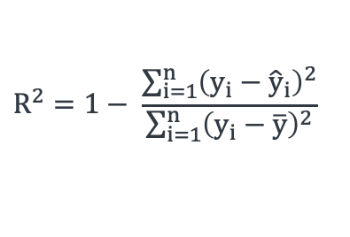
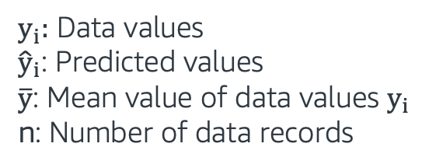
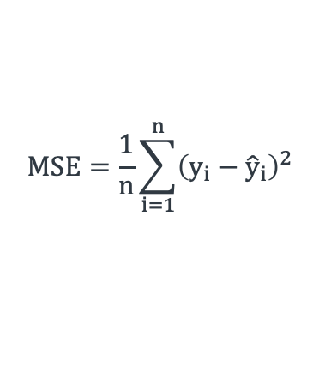
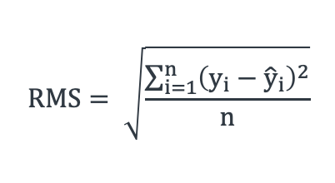
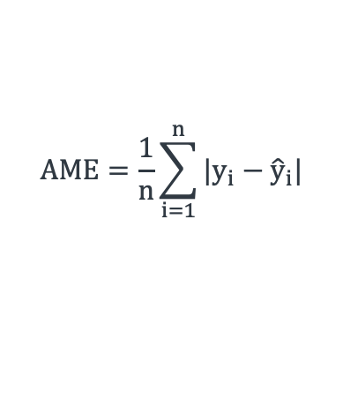
Evaluating Regression Models
Metrics | Equations
Mean Squared Error (MSE)
Root Mean Squared Error (RMSE)
Absolute Mean Error (AME)
R Squared (R²)
$y_{i}:$ Data values
${\hat{y}}_{i}$: Predicted values
$\overline{y}$: Mean value of data values $y_{i}$
n: Number of data records
$$MSE=\frac{1}{n}\sum_{i=1}^{n}{{\left(y_{i}−{\hat{y}}_{i}\right)}^{2}}$$
$$RMS= \sqrt{\frac{\sum_{i=1}^{n}{{\left(y_{i}−{\hat{y}}_{i}\right)}^{2}}}{n}}$$
$$AME=\frac{1}{n}\sum_{i=1}^{n}{{|y}_{i}−{\hat{y}}_{i}|}$$
$$R^{2}=1− \frac{\sum_{i=1}^{n}{{\left(y_{i}−{\hat{y}}_{i}\right)}^{2}}}{\sum_{i=1}^{n}{{\left(y_{i}−\overline{y}\right)}^{2}}}$$

Slide 33
Evaluating Classification Models
Prediction
True Positive: Predicted ‘Positive’
when the actual is ‘Positive’
False Positive: Predicted ‘Positive’
when the actual is ‘Negative’
False Negative: Predicted ‘Negative’
when the actual is ‘Positive’
True Negative: Predicted ‘Negative’
when the actual is ‘Negative’
Positive
Negative
True Positive
False Negative
Positive
19
2
True State
False Positive
True Negative
Negative
1
3

Slide 34
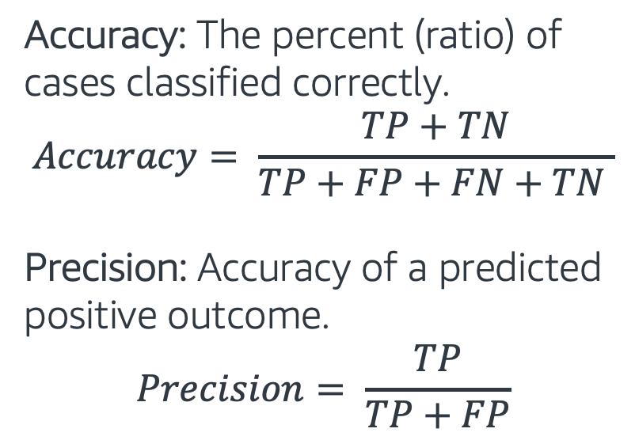
Classification - Accuracy, Precision
Prediction
Positive
Negative
Accuracy: The percent (ratio) of cases classified correctly.
$$Accuracy= \frac{TP+TN}{TP+FP+FN+TN }$$
Precision: Accuracy of a predicted positive outcome.
$$Precision= \frac{TP}{TP+FP}$$
True Positive
False Negative
Positive
19
2
True State
False Positive
True Negative
Negative
1
3

Slide 35
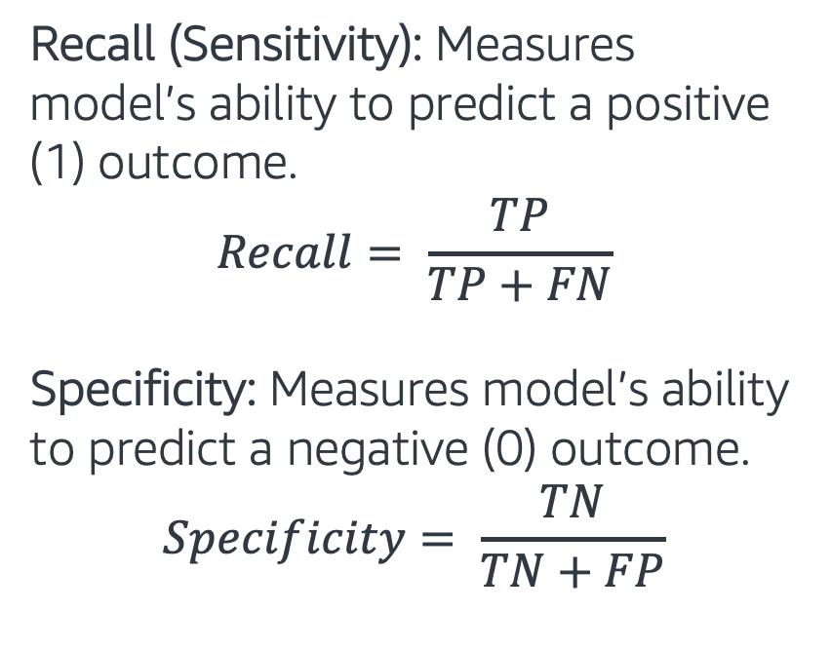
Classification - Recall, Specificity
Prediction
Recall (Sensitivity): Measures model’s ability to predict a positive (1) outcome.
$$Recall= \frac{TP}{TP+FN}$$
Specificity: Measures model’s ability to predict a negative (0) outcome.
$$Specificity= \frac{TN}{TN+FP}$$
Positive
Negative
True Positive
False Negative
Positive
19
2
True State
False Positive
True Negative
Negative
1
3

Slide 36
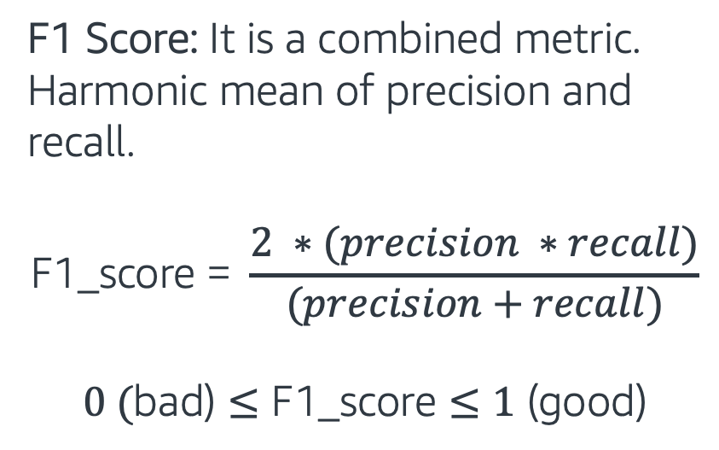
Classification - F1 Score
F1 Score: It is a combined metric. Harmonic mean of precision and recall.
$$\text{F}\text{1_}\text{score}\text{ = }\frac{2 ∗(precision ∗recall)}{(precision+recall)}$$
$$0 (\text{bad}\text{)}≤\text{F}\text{1_}\text{score}≤1\text{ (}\text{good}\text{)}$$
Recall
F1 score
Precision

Slide 37
Topics for Day 1
Introduction to Machine Learning
Data Processing
Model Evaluation
Text Processing
Bag of Words Method (BoW)
K Nearest Neighbors Model (KNN)
Final Project

Slide 38
Tokenization
Tokenization: Separates text into small parts by white space and punctuation.
Sentence: “I don’t like eggs.”
Tokens: “I”, “do”, “n’t”, “like”, “eggs”, “.”
We base our next processes on these tokens.

Slide 39
Text Cleaning Operations
We can encounter different types of problems. Some common examples:
Leading/trailing white spaces and extra white spaces/tabs
HTML and XML markups
Misspellings
Acronyms: NASA, ETA etc
Phone numbers, dates: +14256565, 12/11/2013

Slide 40
Stop Words Removal
Some words commonly appear in our texts, but they don’t contribute too much to the overall meaning. We remove them from the text.
Common stop words: “a”, “the”, “so”, “is”, “it”, “at”, “in”, “this”, “there”, “that”, “my”
Example:
Original sentence: “There is a tree near the house”
Without stop words: “tree near house”

Slide 41
Stemming
Stemming: Set of rules to slice a string to a substring that usually refers to a more general meaning.
The goal is to remove word affixes (particularly suffixes) such as “s”, “es”, “ing”, “ed”, etc.
“playing”
“played” “play”
”plays”
It is a simple method and it doesn’t usually work with irregular forms such as irregular verbs: “taught”, “brought”, etc.

Slide 42
Lemmatization
Lemmatization: It looks up the words in dictionary and returns the “head” word called a “lemma”
It handles more situations and usually works better than stemming.
-“taught” -”am”
-“teaching” “teach” -”is” “be”
-“teaches” -“are”
For the best results, correct word position tags should be provided: “adjective”, “noun”, “verb” etc.

Slide 43
Stemming vs. Lemmatization
As we pointed out, lemmatization is a more complex method and usually works better.
Original sentence: "the children are playing outside. the weather was better yesterday."
Stemming => “the children are play outside. the weather was better yesterday”
Lemmatization => “the child be play outside. the weather be good yesterday”

Slide 44
Text Processing - Hands on
In this exercise, we will go over:
Simple text cleaning processes
Stop words removal
Stemming, Lemmatization
Follow through this notebook: “EMBK-NLP-DAY1-TEXT-PROCESS-NB.ipynb”

Slide 45
Topics for Day 1
Introduction to Machine Learning
Data Processing
Model Evaluation
Text Processing
Bag of Words Method (BoW)
K Nearest Neighbors Model (KNN)
Final Project

Slide 46
Bag of Words (BoW)
Text data is difficult to work with. Machine learning models need well-defined numerical data.
Bag of Words method converts text data into numerical features.
We call this operation “Feature extraction”, as it gives us important information about the text in a numeric form.
With BoW, we get a number for each word in a sentence. It can be binary (present or not), word counts or frequencies.
Let’s look at an example on the next slide.

Slide 47
Bag of Words (BoW)
Example:
sentence_1 = “This is the first document”
sentence_2 = “This is the second document”
sentence_3 = “and the third one”
Binary features (word in the sentence or not):
vocabulary = {“and”, “document”, “first”, “is”, “one”, “second”, “the”, “third”, “this”}
 | and | document | first | is | one | second | the | third | this
sentence_1 | 0 | 1 | 1 | 1 | 0 | 0 | 1 | 0 | 1
sentence_2 | 0 | 1 | 0 | 1 | 0 | 1 | 1 | 0 | 1
sentence_3 | 1 | 0 | 0 | 0 | 1 | 0 | 1 | 1 | 0

Slide 48
Term Frequencies
Term Frequency: How important is a word to the document
sentence_1 = “This is the first document”
sentence_2 = “This is the second document”
sentence_3 = “and the third one”
$term_freq(term, doc)$= $\frac{number of times the term occurs in the doc}{total number of terms in the doc}$
vocabulary = {“and”, “document”, “first”, “is”, “one”, “second”, “the”, “third”, “this”}
 | and | document | first | is | one | second | the | third | this
sentence_1 | 0 | 0.2 | 0.2 | 0.2 | 0 | 0 | 0.2 | 0 | 0.2
sentence_2 | 0 | 0.2 | 0 | 0.2 | 0 | 0.2 | 0.2 | 0 | 0.2
sentence_3 | 0.25 | 0 | 0 | 0 | 0.25 | 0 | 0.25 | 0.25 | 0

Slide 49
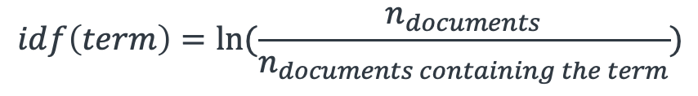
Term Frequency – Inverse Doc. Freq.
Term frequency (TF): | Increases the weight for common words in a document.
Inverse document frequency (IDF): | Decreases the weights for commonly used words and increases weights for rare words in the vocabulary.
Term Freq. Inverse Doc. Freq (TF-IDF): | Combines term frequency and inverse document frequency.
$term_freq(term, doc)$= $\frac{number of times the term occurs in the doc}{total number of terms in the doc}$
$$idf\left(term\right)=ln⁡(\frac{n_{documents}}{n_{documents containing the term}})$$
$$tf_idf\left(term,doc\right)=tf\left(term, doc\right)xidf(term)$$

Slide 50
Feature Extraction - Hands on
Sklearn library provides nice implementations of the Bag of Words method.
In this exercise, we will get these types of features:
Binary
Word Counts
Term Frequency (TF)
Term Freq – Inverse Document frequency (TF-IDF)
Follow through this notebook: “EMBK-NLP-DAY1-BOW-NB.ipynb”

Slide 51
Topics for Day 1
Introduction to Machine Learning
Data Processing
Model Evaluation
Text Processing
Bag of Words Method (BoW)
K Nearest Neighbors Model (KNN)
Final Project

Slide 52
K Nearest Neighbors (KNN)
K Nearest Neighbors (KNN) model predicts new data points based on the similar other records in a dataset.
Algorithm:
Find “K” similar records
For classification (predict class):
Take the majority class of those K records
For regression (predict numerical value):
Take the average value of those K records
Class 1:
Class 2:
X₂
X₁

Slide 53
K Nearest Neighbors (KNN) Classifier
Assume a dataset:
Two classes: and
Two features X₁ and X₂
K Nearest Neighbor Model:
K=3
Class 1:
Class 2:
X₂
X₁

Slide 54
K Nearest Neighbors (KNN) Classifier
Assume a dataset:
Two classes: and
Two features X₁ and X₂
K Nearest Neighbor Model:
K=3
What class does belong?
Class 1:
Class 2:
X₂
?
?
X₁

Slide 55

K Nearest Neighbors (KNN) Classifier
Assume a dataset:
Two classes: and
Two features X₁ and X₂
K Nearest Neighbor Model:
K=3
What class does belong?
Look at the closest K points
Pick the majority class:
Class 1:
Class 2:
X₂
?
?
X₁

Slide 56
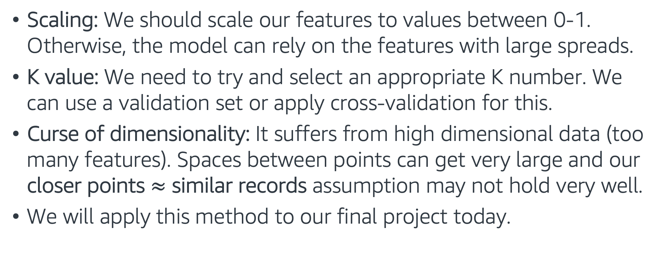
K Nearest Neighbors (KNN) Classifier
Scaling: We should scale our features to values between 0-1. Otherwise, the model can rely on the features with large spreads.
K value: We need to try and select an appropriate K number. We can use a validation set or apply cross-validation for this.
Curse of dimensionality: It suffers from high dimensional data (too many features). Spaces between points can get very large and our closer points $≈$ similar records assumption may not hold very well.
We will apply this method to our final project today.

Slide 57
Putting it all together - Hands on
In this exercise, we work with our final project dataset (but we will predict a different field, log_votes)
The exercise covers the following topics:
Training-validation-test split
Text cleaning and Bag of Words feature extraction
ML Model: K Nearest Neighbors (KNN) Regressor
Follow through this notebook: “EMBK-NLP-DAY1-KNN-NB.ipynb”

Slide 58
Topics for Day 1
Introduction to Machine Learning
Data Processing
Model Evaluation
Text Processing
Bag of Words Method (BoW)
K Nearest Neighbors Model (KNN)
Final Project

Slide 59
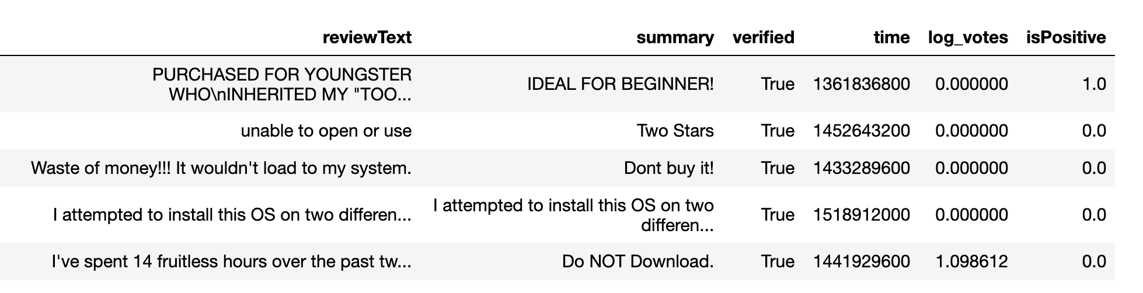
Final Project – Sentiment Analysis
Data: Customer reviews. Let's look at first 5 rows of the training dataset:
Task: Train a classifier to predict the isPositive field for the test dataset.
Follow through this notebook ”EMBK-NLP-DAY1-FINAL-STUDENT-NB.ipynb” to start on the final project.

Slide 60
Notebooks for Day 1
EMBK-NLP-DAY1-TEXT-PROCESS-NB.ipynb: Text processing:
EMBK-NLP-DAY1-BOW-NB.ipynb: Bag of Words Features:
EMBK-NLP-DAY1-KNN-NB.ipynb: KNN for Regression
EMBK-NLP-DAY1-FINAL-STUDENT-NB.ipynb: Final Project Walkthrough for Day 1
EMBK-NLP-DAY1-FINAL-SOLUTION-NB.ipynb: Final Project Solution for Day 1

Slide 61
Looking Ahead - Day 2
Tree-based Models
Regression Models
Optimization
Regularization
Hyperparameter Tuning
AWS AI/ML Services

